Slide 1
















72 $V_{pp}$
$$V_{AB}$$
1.6 $A_{DC}$
$$I_{OUT1}$$
0.5 $A_{DC}$
$$I_{OUT2}$$
1.6 $A_{DC}$
0.36 $A_{RMS}$
0.65 $A_{DC}$
0.1 $A_{RMS}$
$$I_{RX2}$$
0.34 $A_{RMS}$
0.14 $A_{RMS}$
$$I_{RX1}$$
$$t_{1}$$
Time : 1 ms/div
$$t_{2}$$

Slide 2





















Time : 1 ms/div
72 $V_{pp}$
$$V_{AB}$$
$$I_{OUT1}$$
0.85 $A_{DC}$
1.55 $A_{DC}$
0.70 $A_{DC}$
2.75 $A_{DC}$
$$I_{OUT2}$$
1.95 $A_{RMS}$
1.48 $A_{DC}$
$$I_{RX2}$$
0.87 $A_{RMS}$
1.75 $A_{RMS}$
$$I_{RX1}$$
3.06 $A_{RMS}$
3.01 $A_{RMS}$
0.82 $A_{RMS}$
$$Δφ_{C}=60$$
$$t_{1}$$
$$Δφ_{C}=180$$
$$t_{2}$$
$$Δφ_{C}=180$$
$$Δφ_{R}=180$$
$$Δφ_{R}=180$$
$$Δφ_{R}=60$$

Slide 3

















Time : 1 ms/div
72 $V_{pp}$
$$V_{AB}$$
$$I_{OUT1}$$
1.08 $A_{DC}$
0.60 $A_{DC}$
0.64 $A_{DC}$
1.46 $A_{DC}$
1.50 $A_{DC}$
$$I_{OUT2}$$
0.83 $A_{RMS}$
1.00 $A_{RMS}$
0.83 $A_{DC}$
$$I_{RX2}$$
0.73 $A_{RMS}$
$$I_{RX1}$$
2.23 $A_{RMS}$
2.30 $A_{RMS}$
1.80. $A_{RMS}$
$$Δφ_{C}=60$$
$$t_{1}$$
$$Δφ_{C}=120$$
$$t_{2}$$
$$Δφ_{C}=110$$
$$Δφ_{R}=90$$
$$Δφ_{R}=90$$
$$Δφ_{R}=0$$

Slide 4
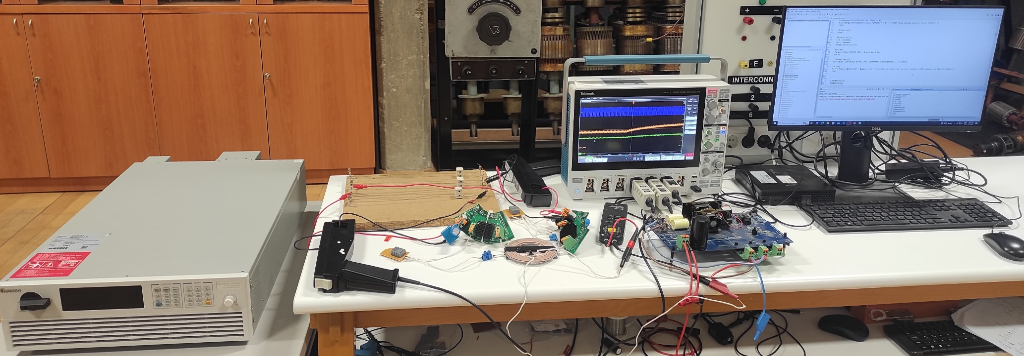
Oscilloscope
Current Probes
Voltage Source
Loads
Voltage Probe
PC
Rectifiers
Resonant Capacitors
WPT coils
Full-bridge Inverter

Slide 5
Oscilloscope
Current Probes
Voltage Source
Loads
Voltage Probe
PC
Rectifiers
Resonant Capacitors
WPT coils
Full-bridge Inverter

Slide 7
FFT

Slide 8
FFT

Slide 9



























Wide
Time : 5 ms/div
72 $V_{pp}$
$$V_{AB}$$
7.55 $V_{DC}$
$$V_{OUT1}$$
16.42 $V_{DC}$
16.63 $V_{DC}$
$$V_{OUT2}$$
6.01 $V_{DC}$
6.15 $V_{DC}$
$$I_{RX1}$$
3.32 $V_{DC}$
1.93 $A_{RMS}$
4.05 $A_{RMS}$
4.15 $A_{RMS}$
$$I_{RX2}$$
1.37 $A_{RMS}$
1.45 $A_{RMS}$
0.72. $A_{RMS}$
$$Δθ_{C}=180$$
$$t_{1}$$
$$Δθ_{C}=180$$
$$t_{2}$$
$$Δθ_{C}=60$$
$$Δθ_{R}=60$$
$$Δθ_{R}=180$$
$$Δθ_{R}=127$$
$$η=50.8 \%$$
$$η=67.7 \%$$
$$η=77.9 \%$$

